Slide 1
Analysis of Air Quality Index
in Chinese Provincial Capital Cities
Group name：Python gogogo！
Group member：23467266 ZHANG Zhengyi
23460520 ZHANGJie
23467886 XIAOXin

Slide 2
CATALOG
01
Introduction
02
The dataset
The air pollution situation in the Beijing-Tianjin-Hebei urban area is extremely contrasting
03
04
Comparison of AQI in heavily polluted cities and first-tier cities with the national average AQI
05
Air quality comparison in China’s livable cities- Changsha, Chengdu, Chongqing, Kunming
06
Conclusion

Slide 3
1
Introduction

Slide 4
1
Introduction
How would you rate the air quality in your hometown or where you currently live?

Slide 5
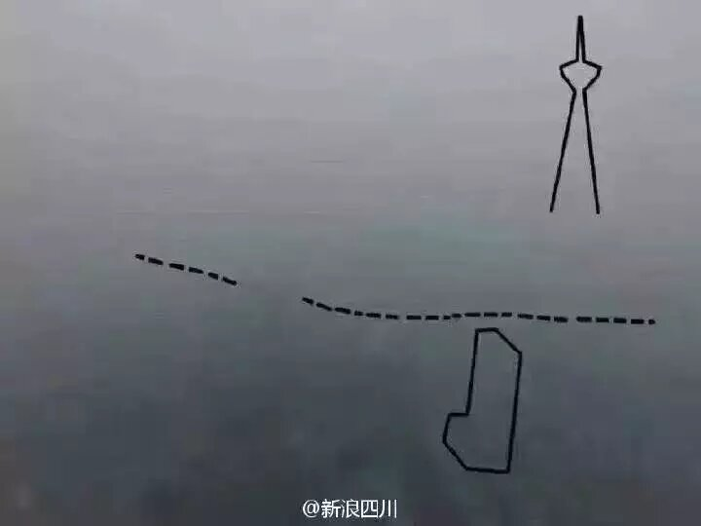
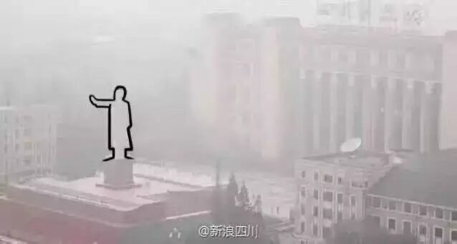
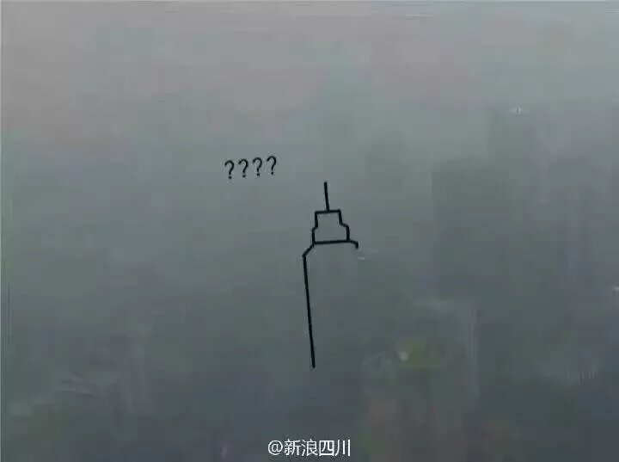
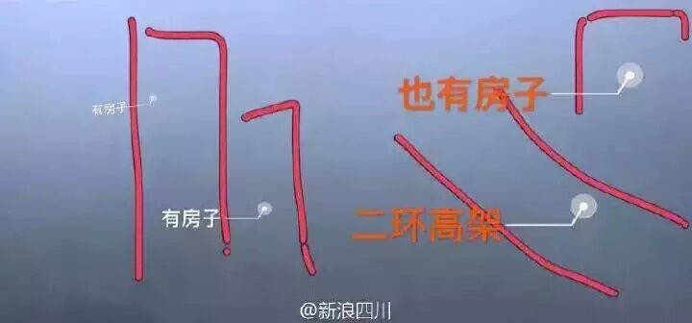
1
Introduction
2013

Slide 6
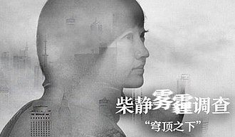
1
Introduction
At the end of February 2015, the documentary "Under the Dome" hosted by Chai Jing went viral on the Internet.

Slide 7
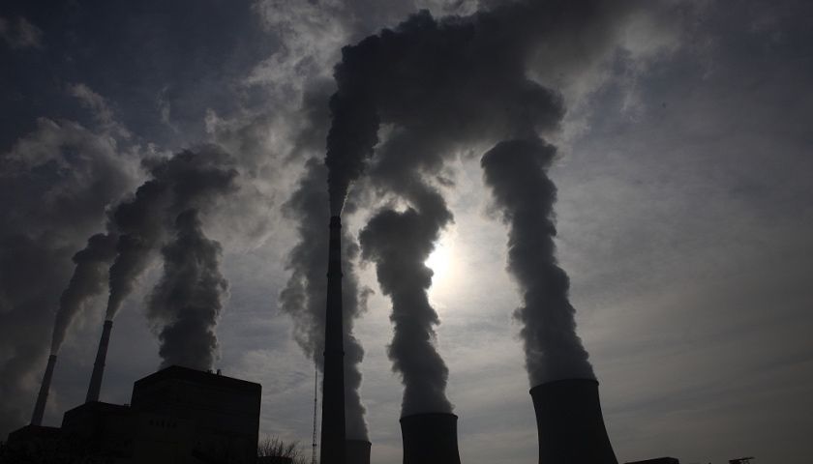
1
Introduction
Overnight, PM2.5, a once professional term, has become a talking point among street aunts. People were panicked for a while, and at the same time, the haze pollution in North China at the end of 2013 brought air pollution and air quality into the public eye.

Slide 8
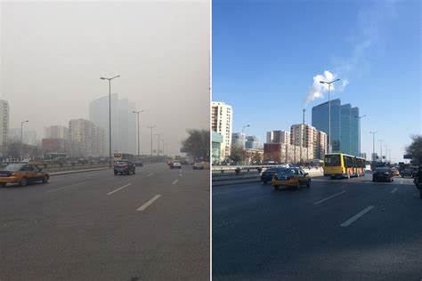
1
Introduction
So today, in 2023,
is our air quality really getting better year by year?

Slide 9
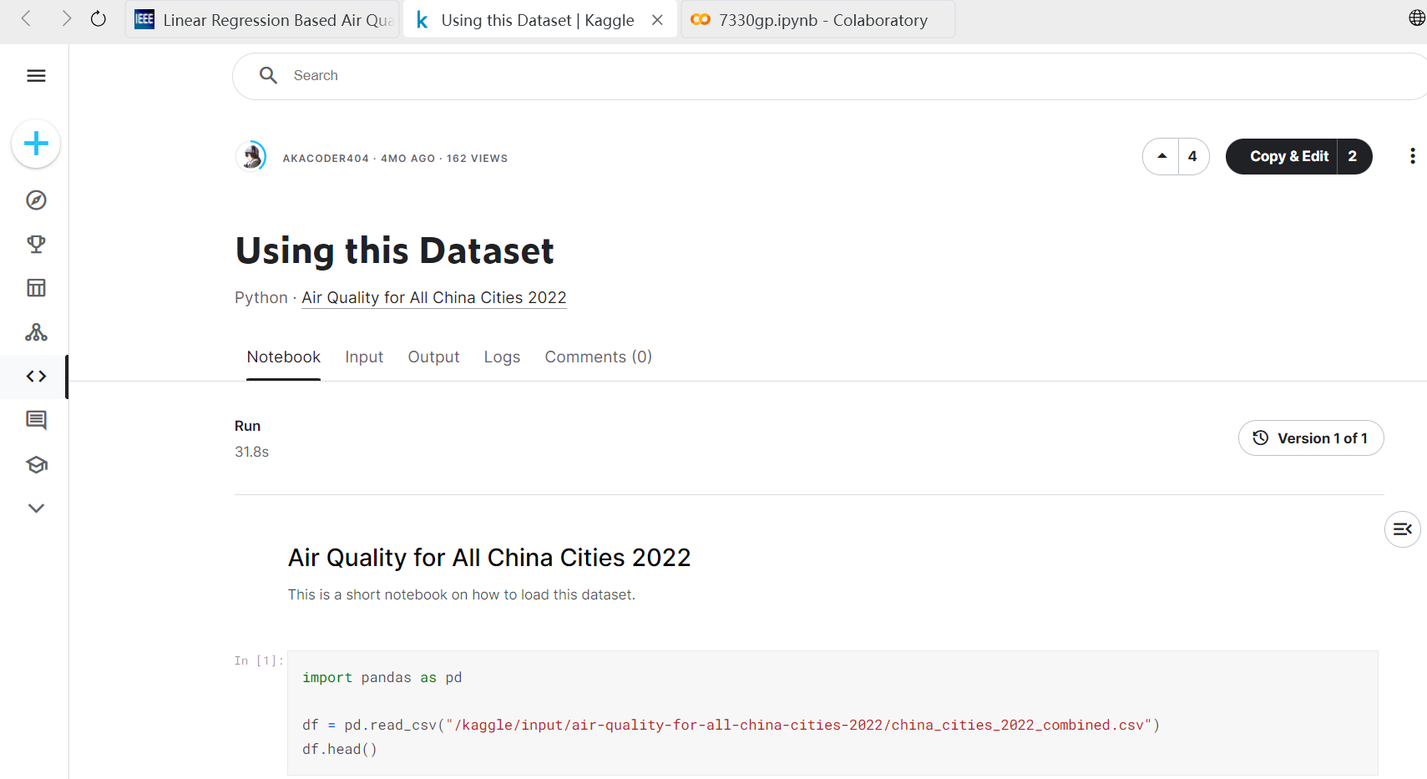
A review of related works(1)
1.https://www.kaggle.com/code/akacoder404/using-this-dataset
The author used the air quality data set of all cities in 2022, imported pandas with python, readcsv files, then obtained the number of rows and columns of the data and the number of days aftergrouping, and then used EDA data visualization (such as curve) to draw the air quality index of thethree key citics.

Slide 10
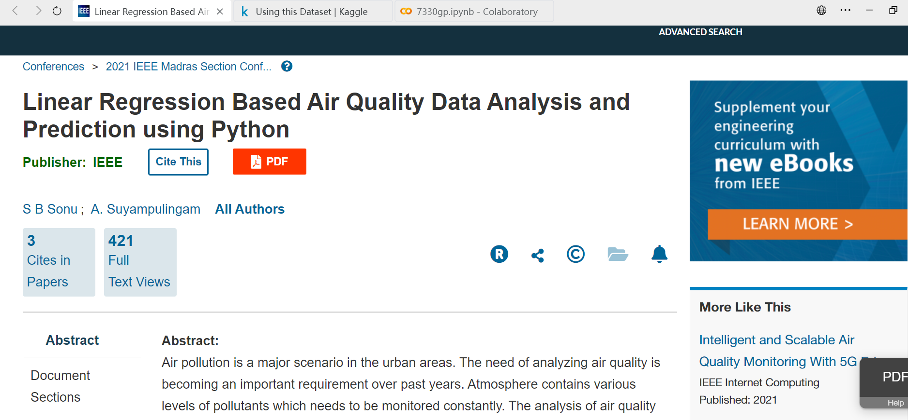
A review of related works(2)
https://ieeexplore.ieee.org/abstract/document/9563432
This paper studies the analysis and prediction of the spatial data quality in the history of aforeign city through the Python platform. The main steps include data collection, data cleaning andpre-processing.

Slide 11
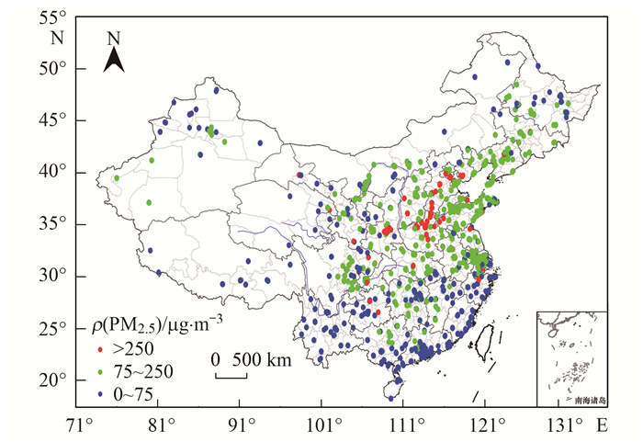
1
Introduction
We will use data to solve the questions we asked, but China is a vast country and we cannot cover everything, so we have chosen three main topics for data visualization.

Slide 12

1
Introduction
Topic1：
The air pollution situation in the Beijing-Tianjin-Hebei urban area is extremely contrasting
Topic2：
Air quality analysis of stereotypical heavily polluted cities & super-first-tier cities
Topic3：
Air quality comparison in China’s livable cities- Changsha, Chengdu, Chongqing, Kunming

Slide 13
2
The dataset

Slide 14
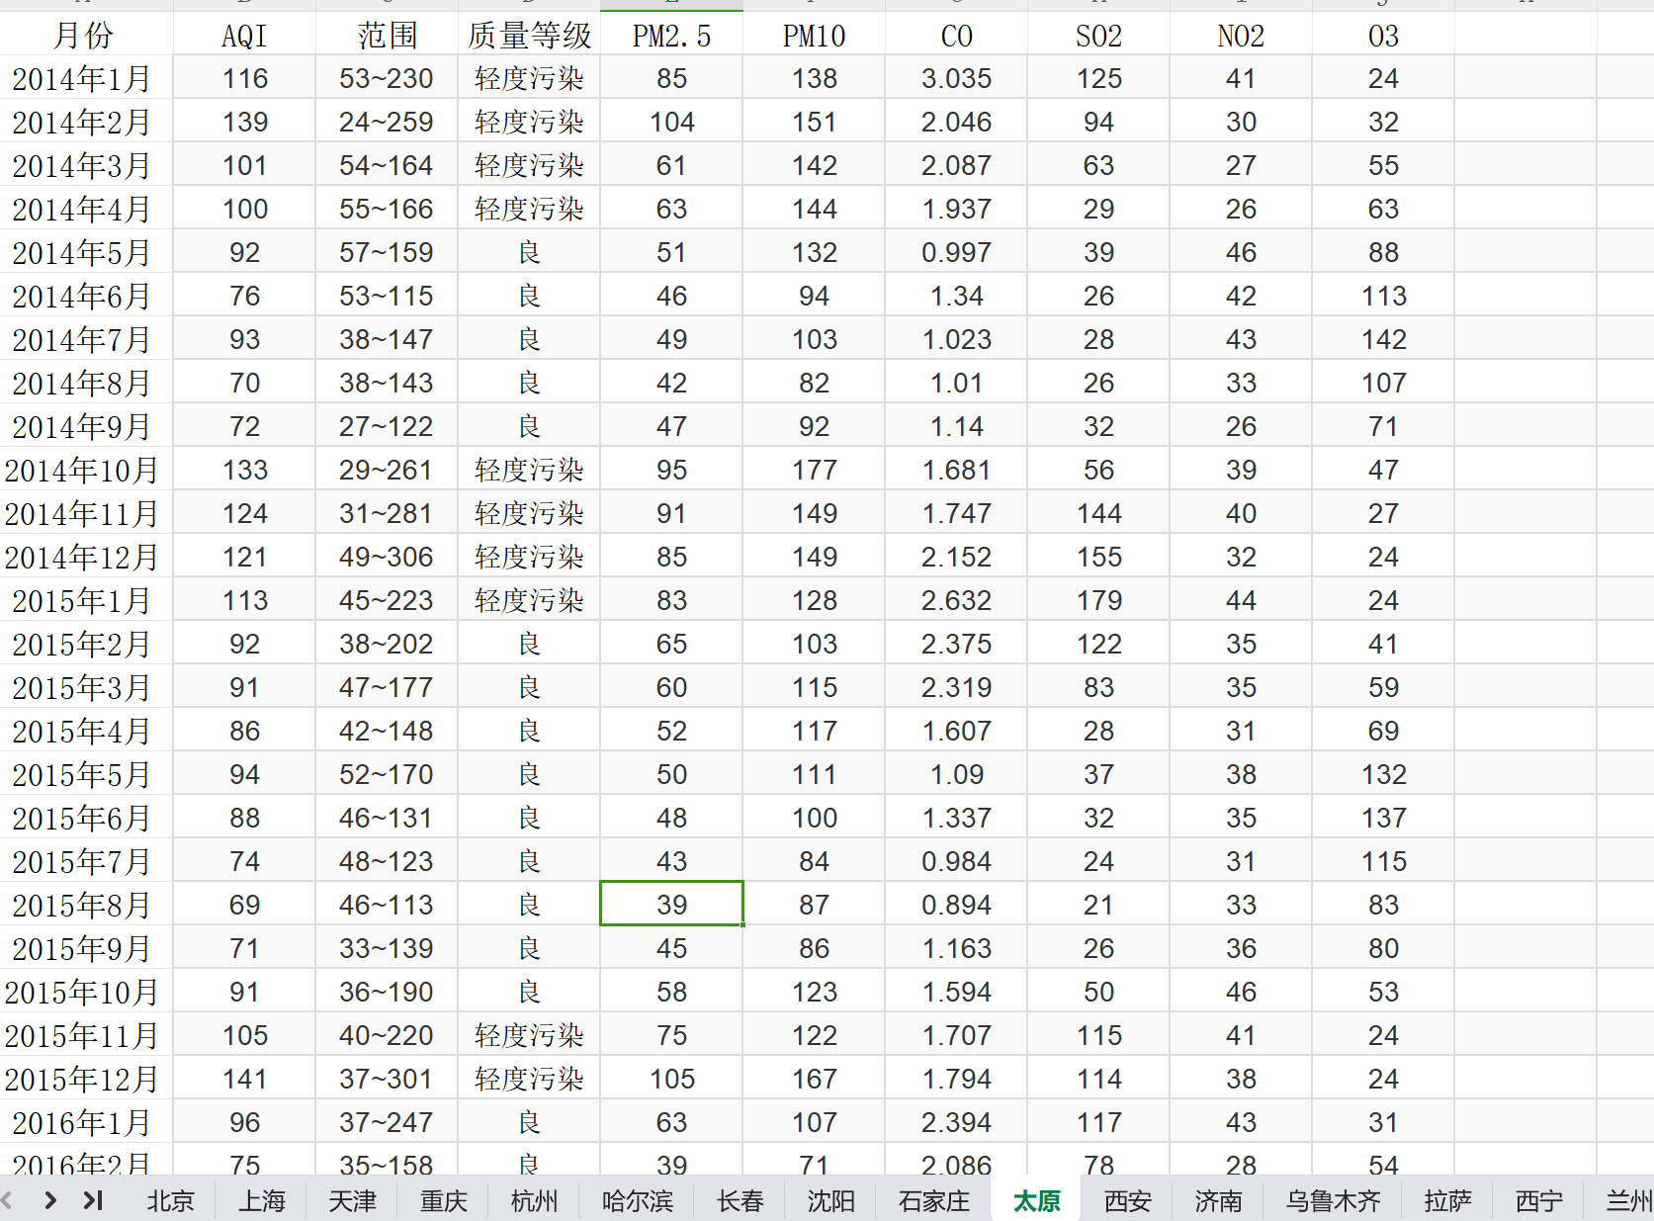
2
The dataset
Data Source
We download this dataset from Kaggle.
This data set contains all air quality data of 34 provincial capital cities in China from 2014 to 2022
including the attributes of time, AQI, range, quality level, PM2.5, PM10, CO, SO2, NO2 and O3

Slide 15
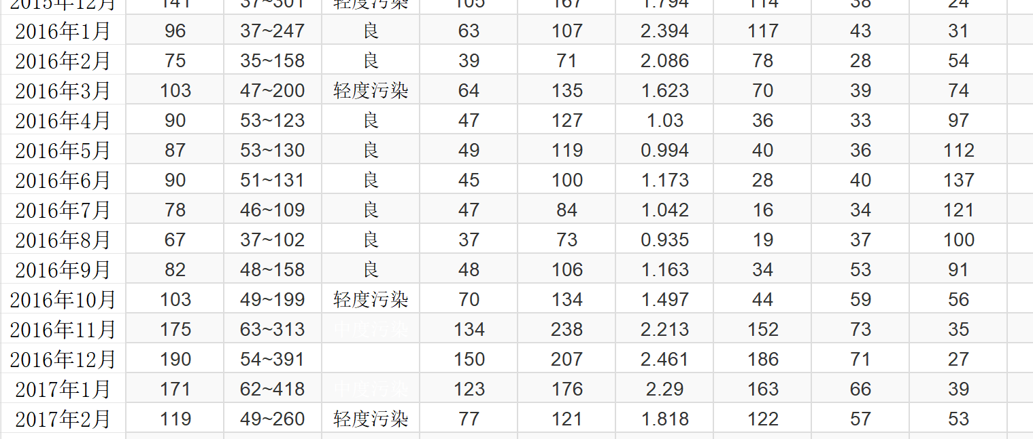
2
The dataset
Data Problem
In Chinese
including lots of sheets in a file
The table is missing some data

Slide 16
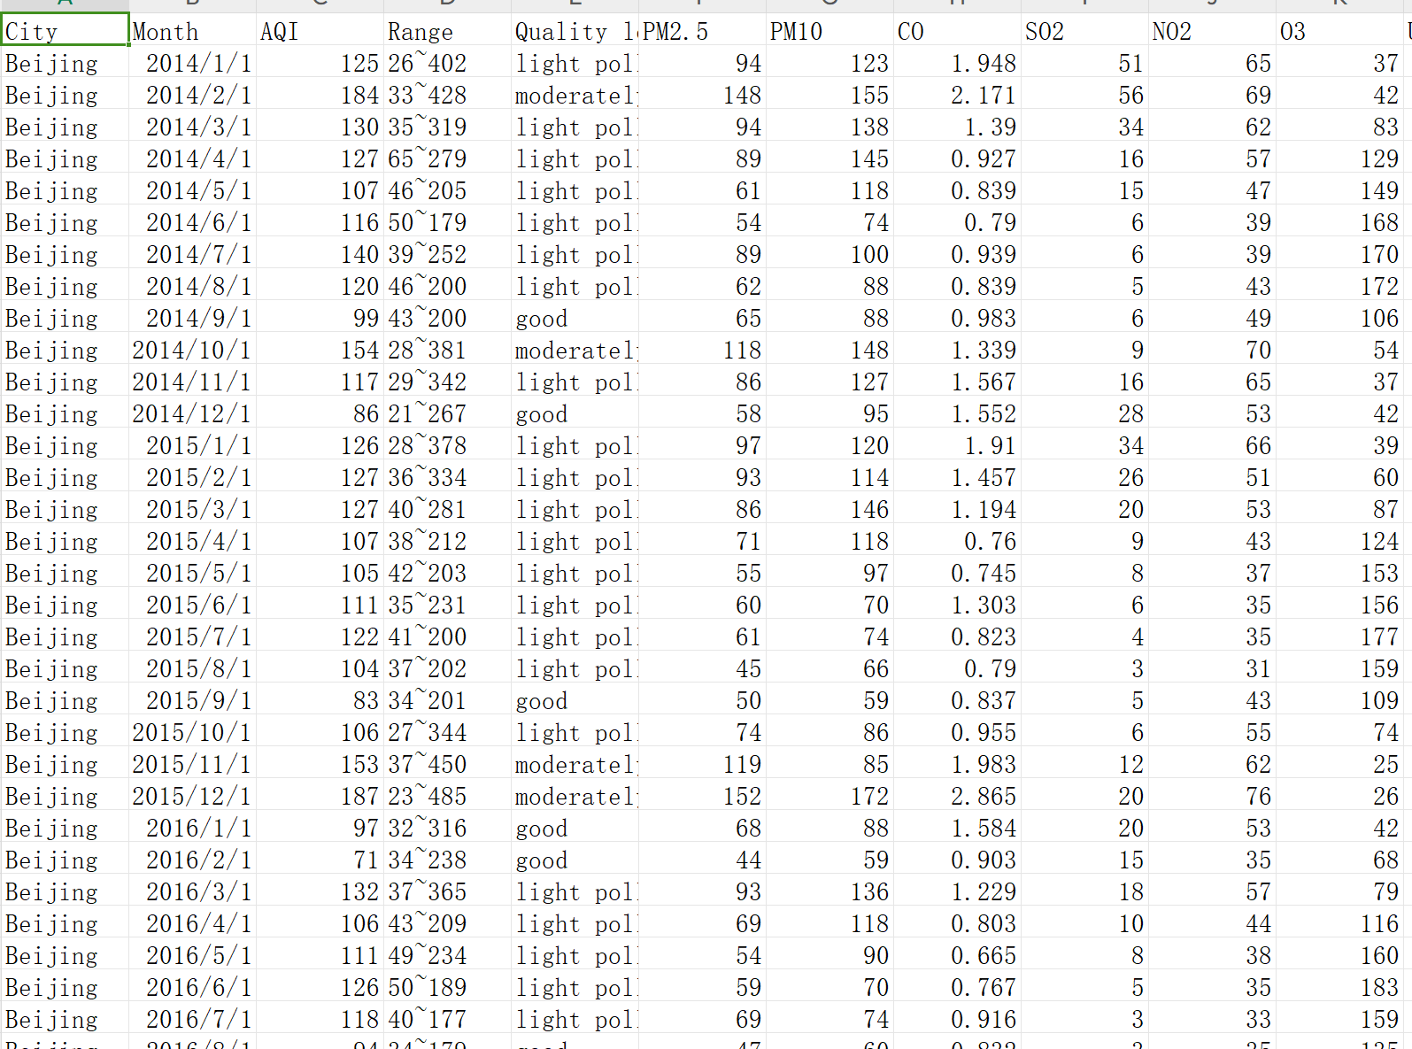
2
The dataset
Data processing before python
Translate all Chinese into English
integrate all the data from 34 provincial capital cities into one table
Add a column name: City
Save the table in CSV format
the processed dataset

Slide 17
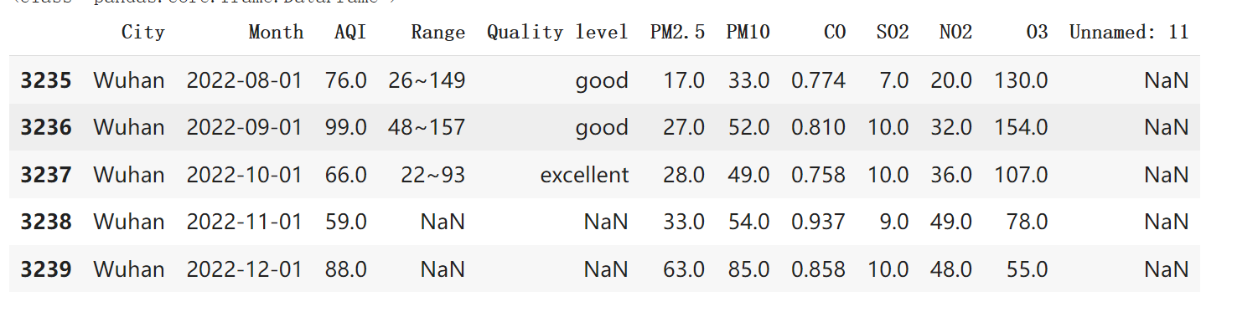

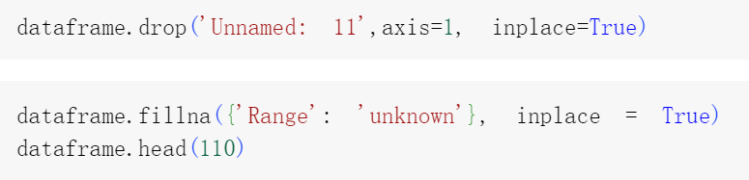
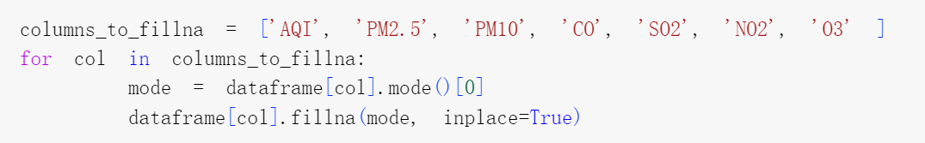
2
The dataset
Data processing in python
drop the last column
Replace ‘NA ‘of the column’Range’ with ‘unknown’
Replace all NA in the column of ‘AQI’,’PM2.5’’PM10’’CO’’SO2’’NO2’’O3’with the highest frequency data of the corresponding column data

Slide 18
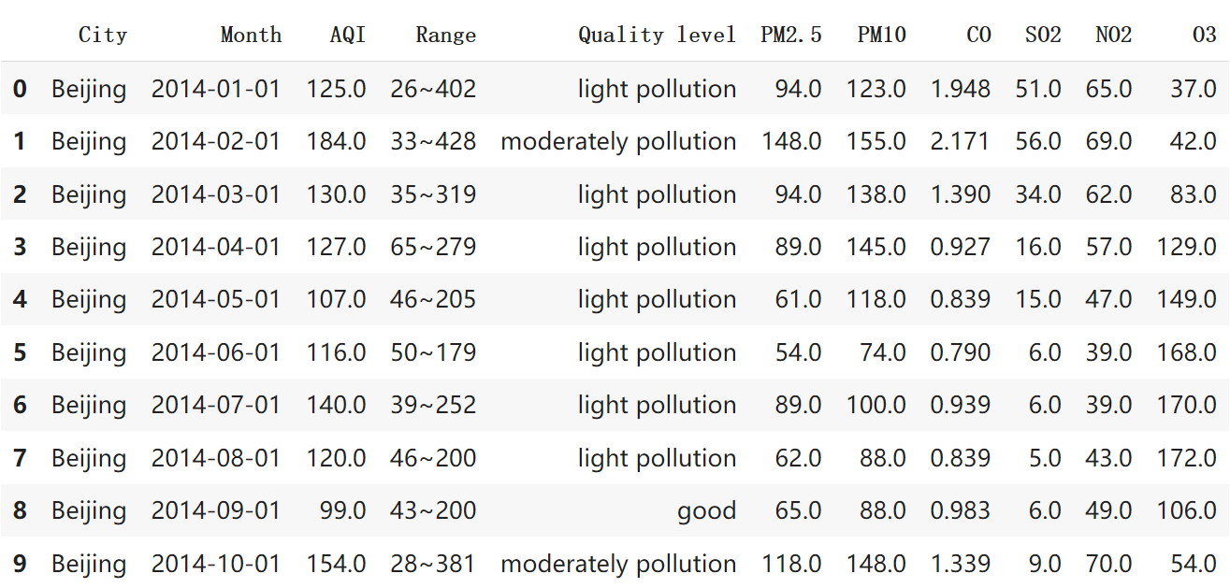
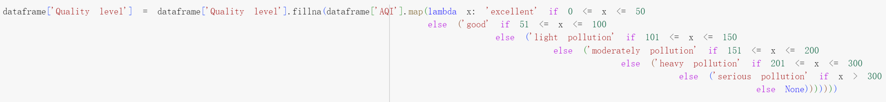
2
The dataset
Data processing in python
For NA in the column ‘Quality Level’, we want to determine the corresponding Quality Level based on the range of AQI, the code is following:
the processed dataset in python

Slide 19
3
The air pollution situation in the Beijing-Tianjin-Hebei urban area is extremely contrasting

Slide 20
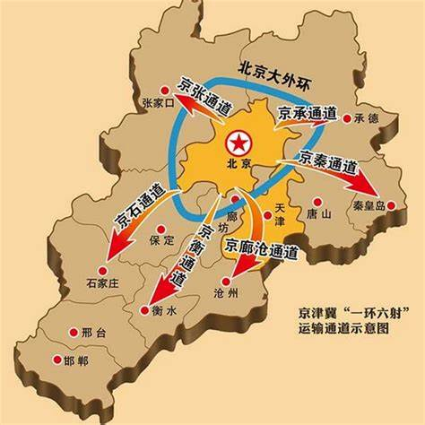
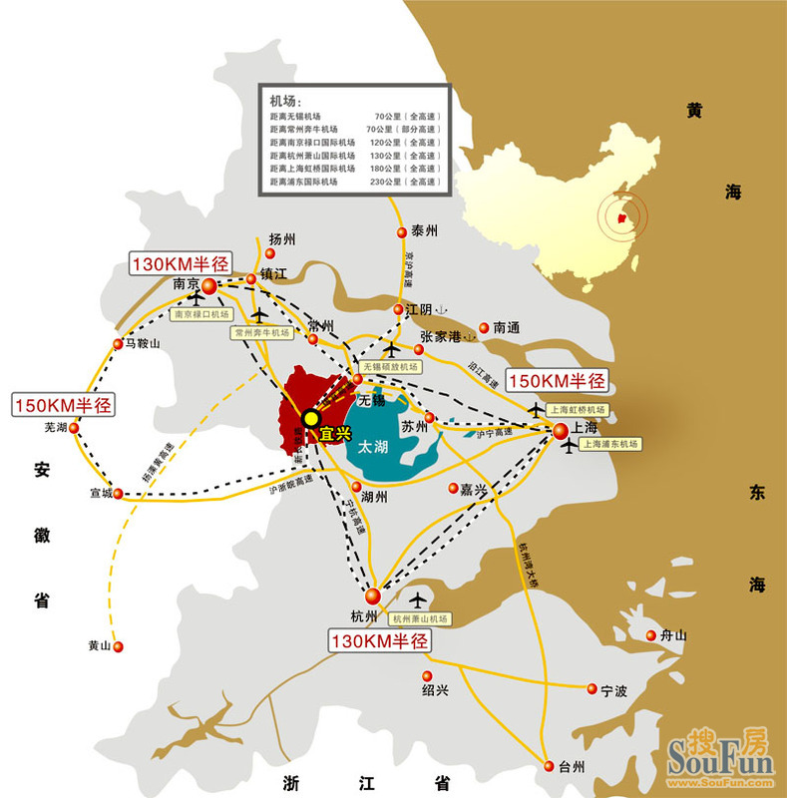
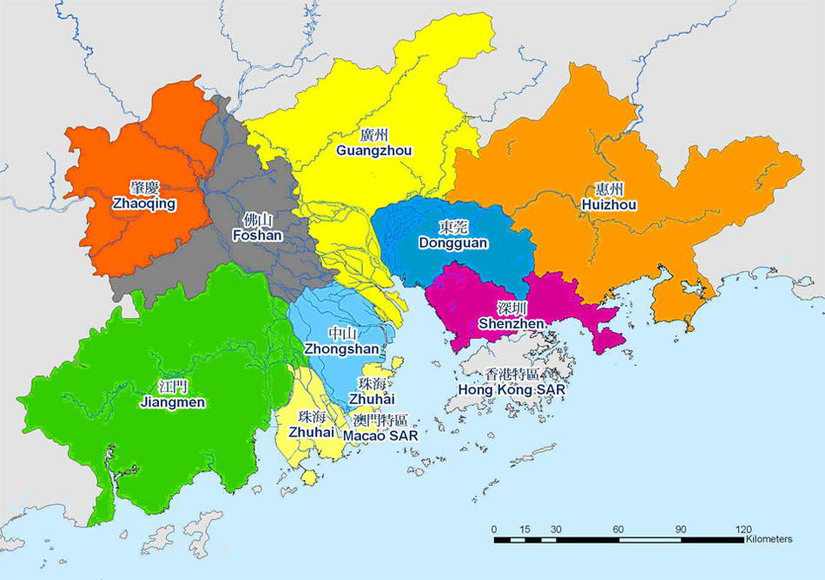
3
Beijing-Tianjin-Hebei urban area
China's main economic centers can be divided into three major regions, the Beijing-Tianjin-Hebei region, the Yangtze River Delta and the Pearl River Delta.

Slide 21
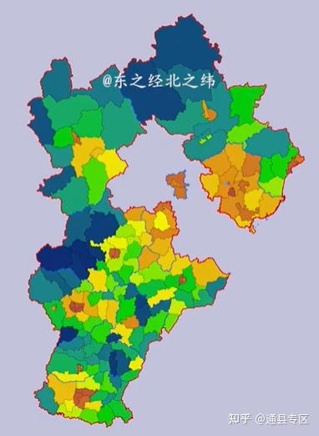
3
Beijing-Tianjin-Hebei urban area
Among them, the Beijing-Tianjin-Hebei urban area does not have a good reputation because there have been rumors that Beijing is sucking the blood of Hebei Province to achieve its own development and has relocated a large number of highly polluting enterprises from Beijing to Hebei Province.

Slide 22
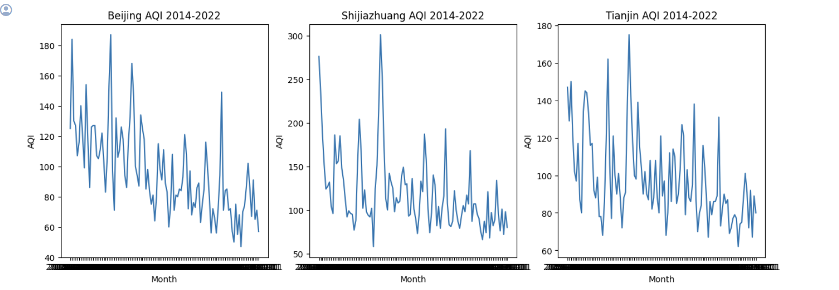
3
Beijing-Tianjin-Hebei urban area
So I want to compare the three cities of Beijing, Shijiazhuang
and Tianjin to verify the authenticity of this rumor.

Slide 23
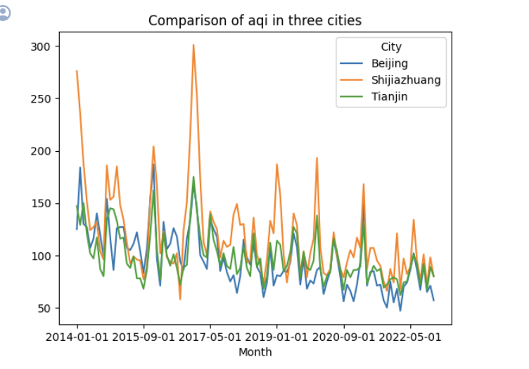
3
Beijing-Tianjin-Hebei urban area
Shijiazhuang’s AQI
curve is much higher than that of Beijing and Tianjin

Slide 24
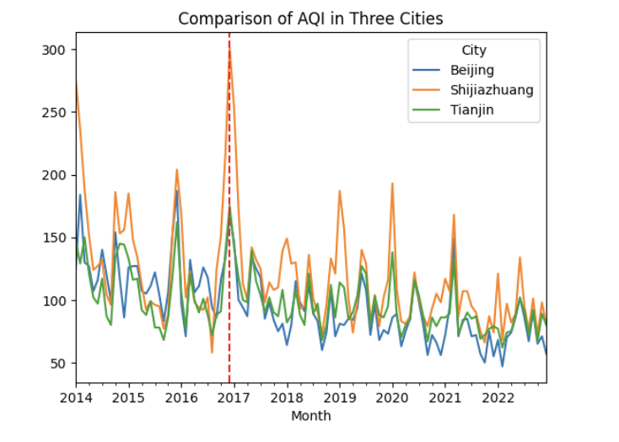
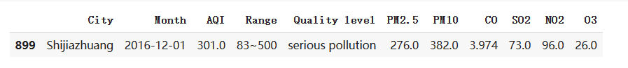
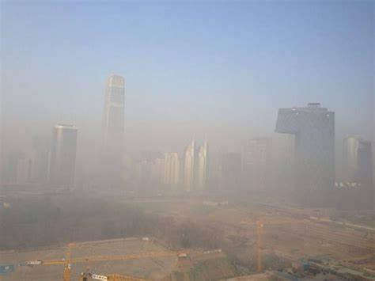
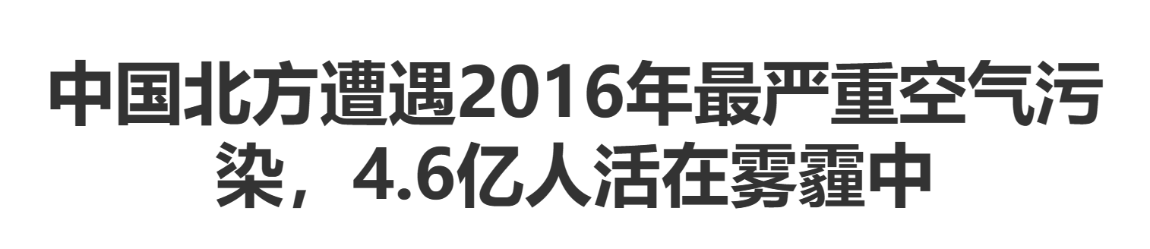
3
Beijing-Tianjin-Hebei urban area
https://www.gov.cn/xinwen/2016-12/19/content_5150173.htm#1
https://www.greenpeace.org.cn/2016/12/20/northern-china-biggest-smog-2016/

Slide 25
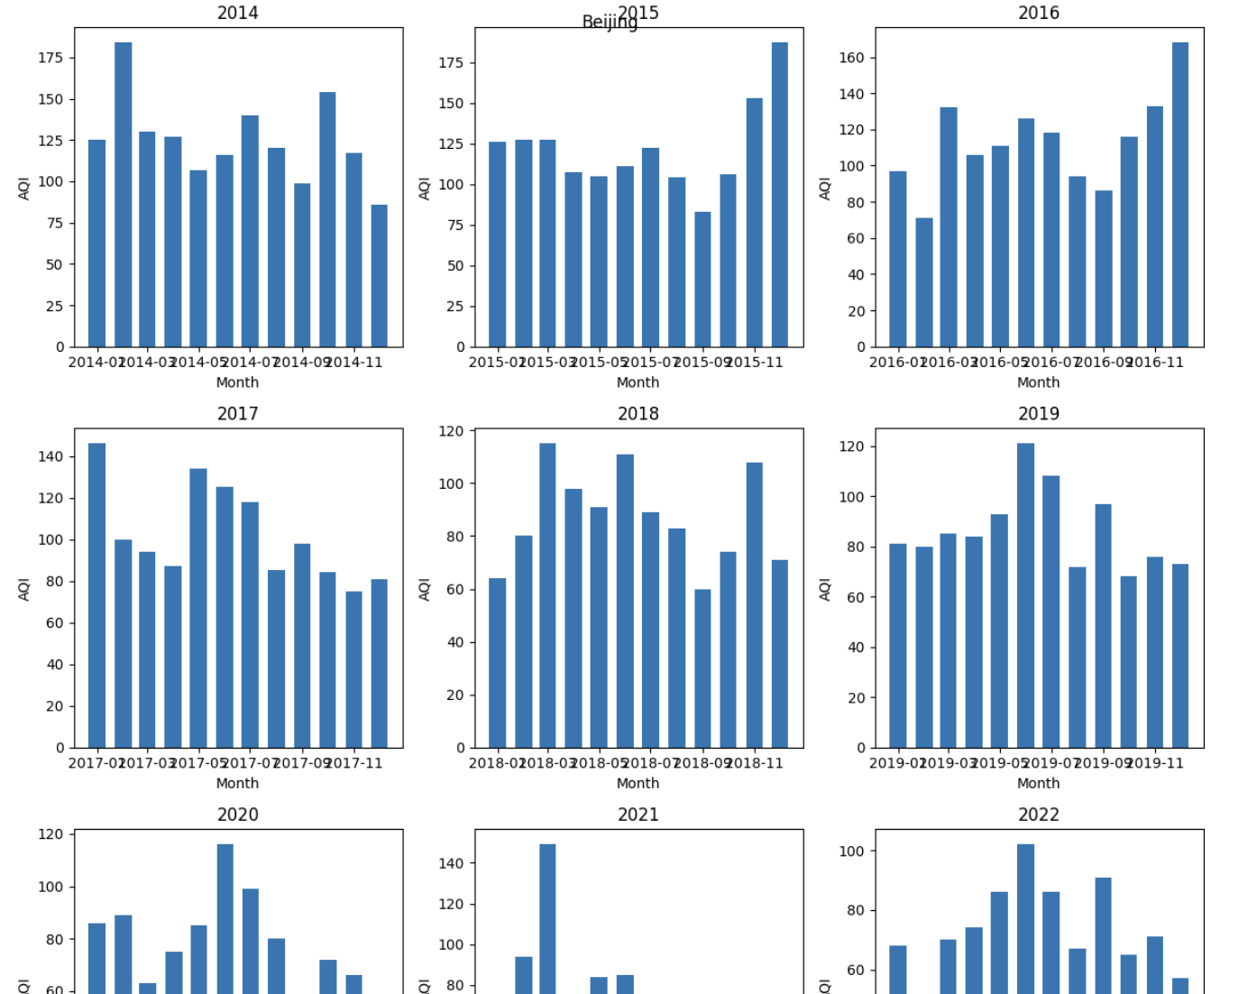
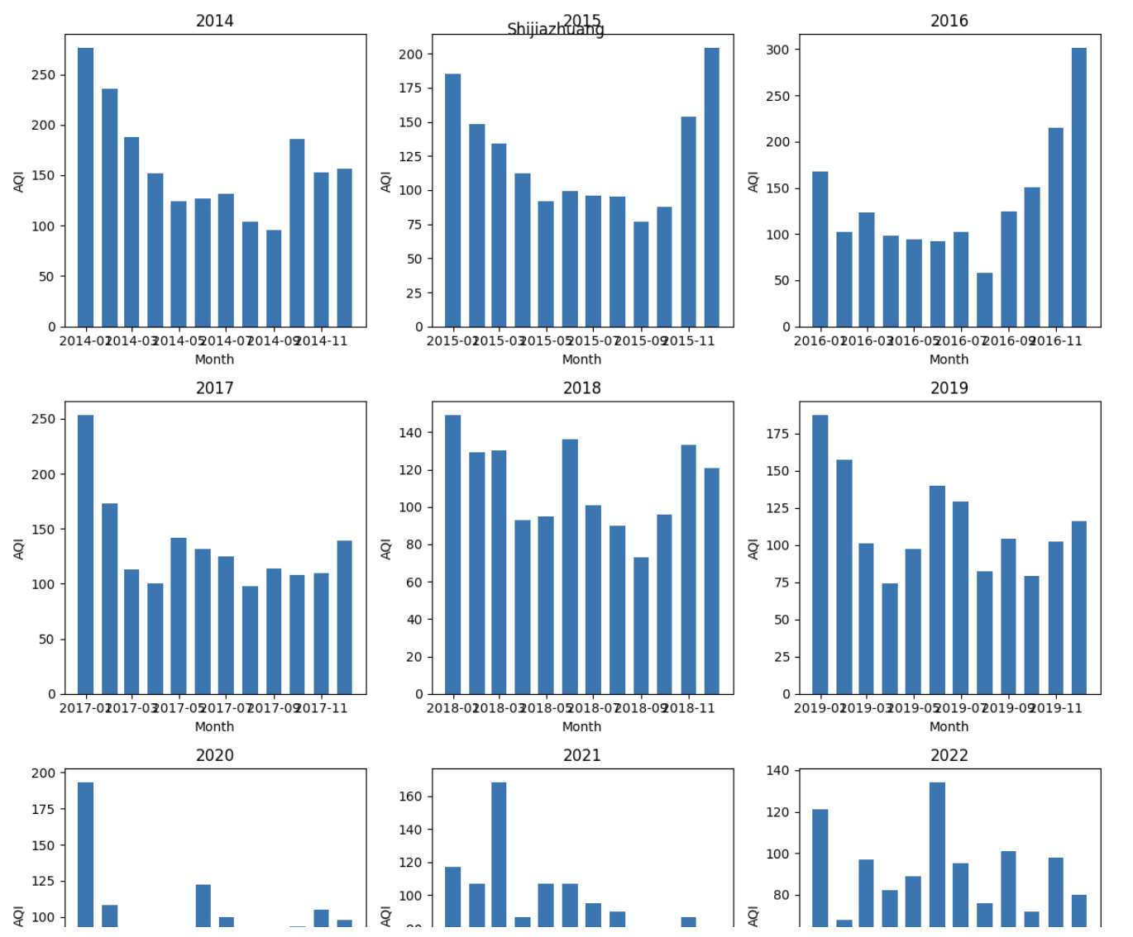
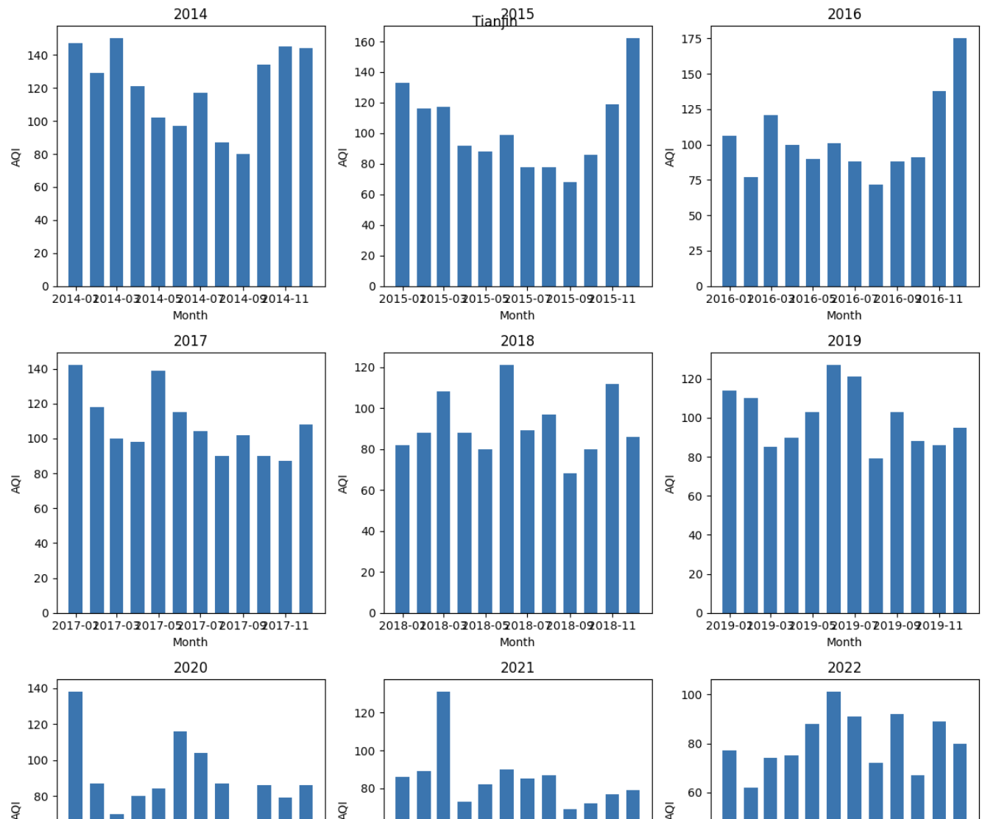
3
Beijing-Tianjin-Hebei urban area
The severe pollution in North China in the winter of 2016 brought me a question:
Will the AQI index in Beijing, Tianjin and Hebei change with seasonal changes?
Beijing
Shijiazhuang
Tianjin

Slide 26
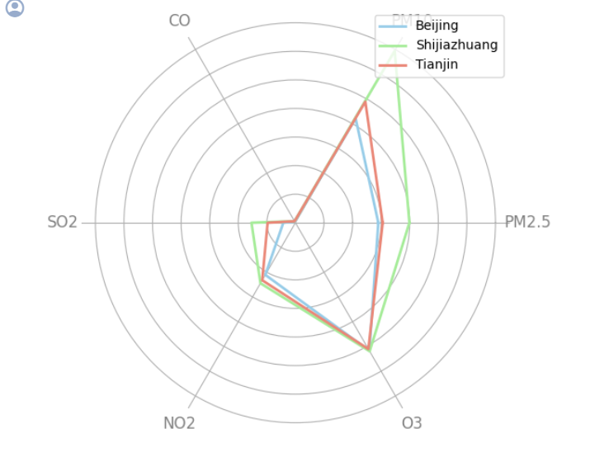
3
Beijing-Tianjin-Hebei urban area
It can be seen from the figure that the proportions of major pollutant components in Beijing, Tianjin and Hebei are roughly the same, but the values in Shijiazhuang are greater than those in Beijing and Tianjin. At the same time, the well-known PM2.5 is not the main component of smog, but PM10.

Slide 27
4
Air quality analysis of stereotypical
heavily polluted cities &
super-first-tier cities (key points)

Slide 28
Content overview
1
Comparison of the AQI of heavily polluted cities
and first-tier cities and the average AQI of provincial capital cities across the country (Histogram*2)
添加标题
Visualization of AQI for super first-tier cities every month in 2022 (Heat map)
Analysis of pollutants in specific months in first-tier cities (Line chart + Box chart)

Slide 29
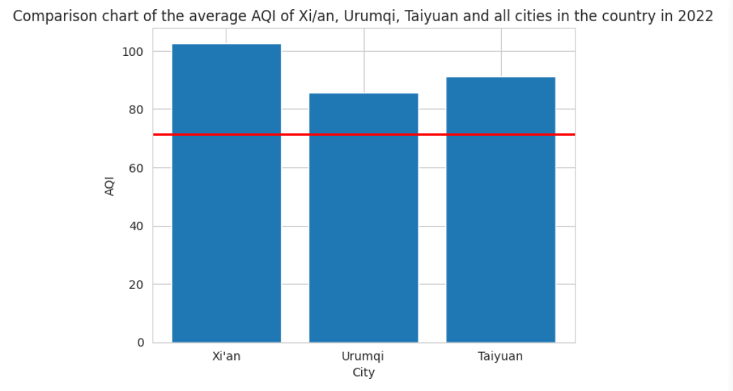
2
Visualize results
AQI in heavily polluted cities
VS
Average AQI of provincial capital cities across the country

Slide 30
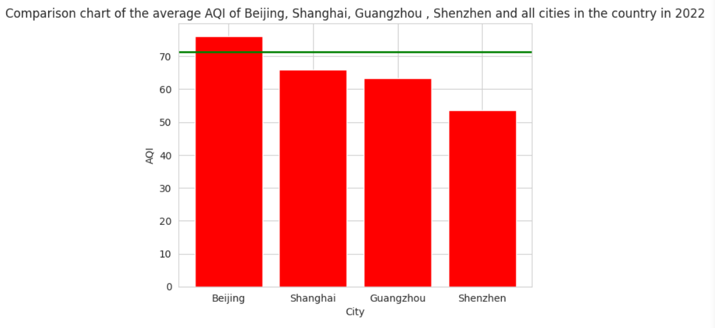
2
Visualize results
AQI of super first-tier cities
VS
Average AQI of provincial capital cities across the country

Slide 31
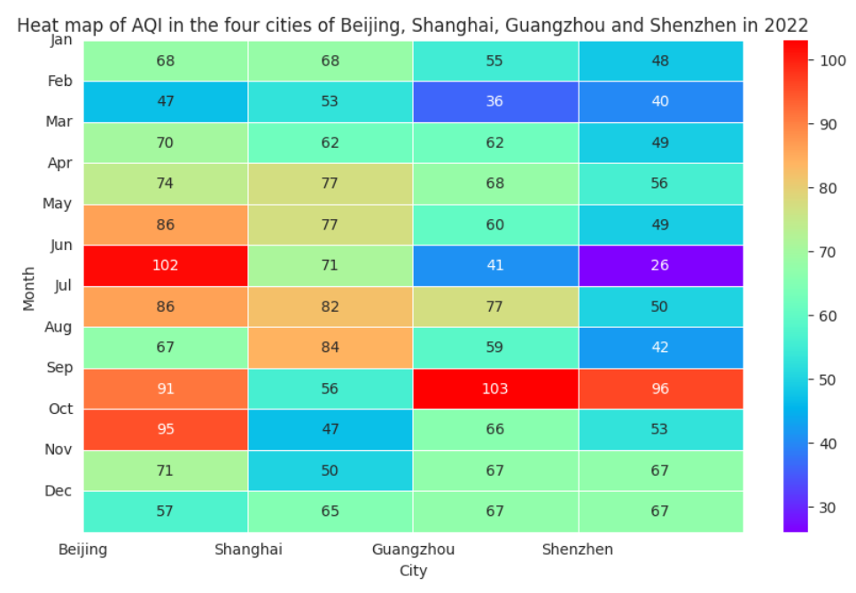
2
Visualize results
AQI of super first-tier cities in 2022

Slide 32
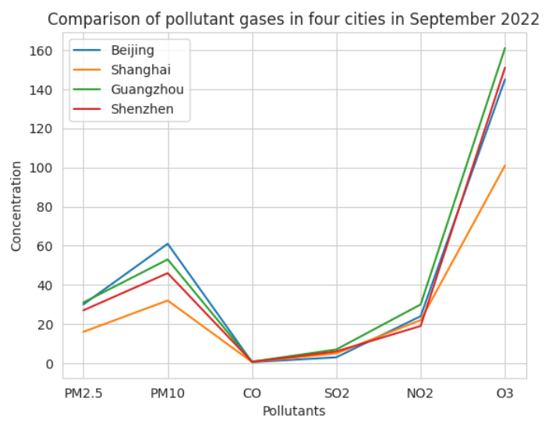
2
Visualize results
Air pollutant concentration in super first-tier cities

Slide 33
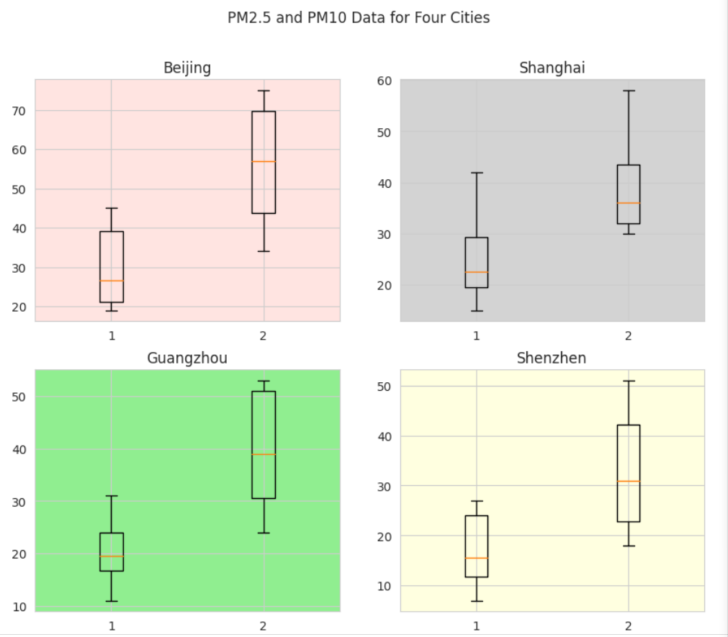
2
Visualize results
Visual display of
key pollutants
(PM2.5 and PM10)

Slide 34
5
China’s livable cities: Changsha, Chengdu, Chongqing, Kunming

Slide 35
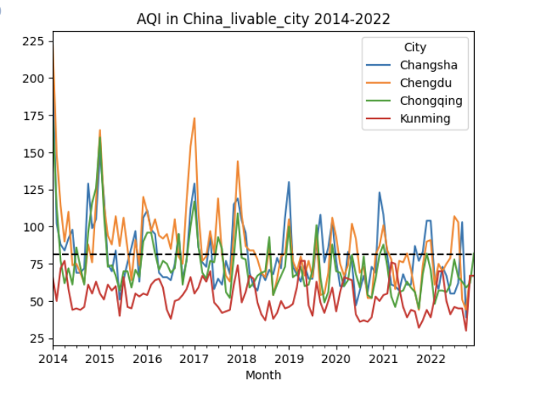
5
China’s livable cities
Exploration1:Compare the AQI index of Changsha, Chengdu, Chongqing, and Kunming, and compare it with the national average AQI index.
The black dotted line in the figure represents the average AQI index of all provincial capital cities in China from 2014 to 2022. As can be seen from the picture above, Kunming’s air quality is significantly better than the other three cities, which are basically lower than the average; Changsha and Chongqing were below average about half of the time; However, Chengdu's overall air quality performance was not good before 2018, but it has improved in recent years.

Slide 36
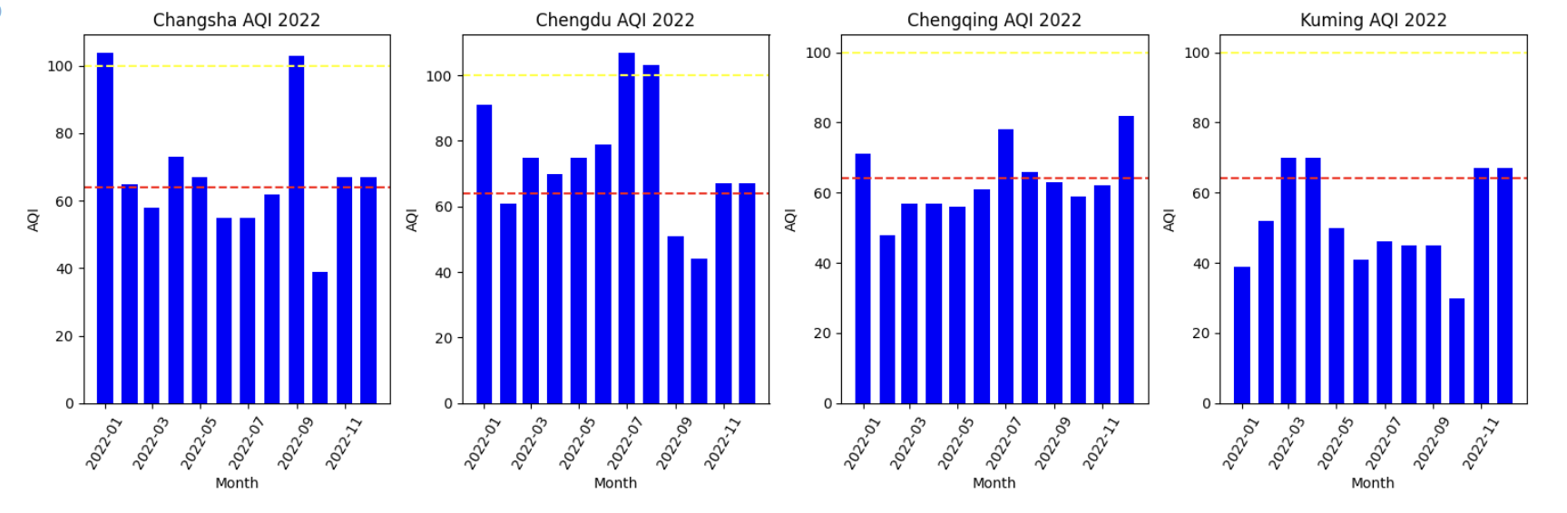
5
China’s livable cities
Exploration2: Comparison of China's livable cities and national AQI values in 2022
We have made 4 subgraphs for the AQI data of 4 cities from January to December 2022. The red dotted line in the figure represents the national AQI average in 2022, and the yellow dotted line represents that the boundary about good and light polution in Quality Level. As can be seen from the figure, in 2022, the air quality in Kunming and Chongqing is below the average, but the air quality performance in Chengdu and Changsha is average, and the Quality Level is light pullotion for two months.

Slide 37
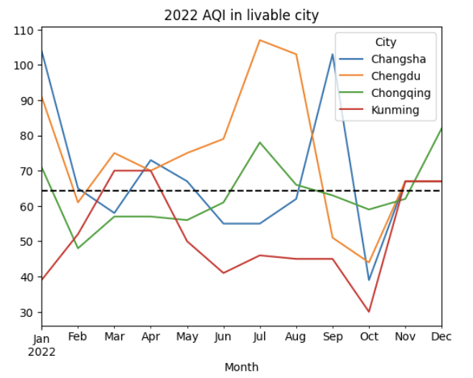
5
China’s livable cities
As can be seen in the figure above, Chengdu’s AQI index has been higher than the national average in most months, and its AQI index was very high in January, July, and August.

Slide 38
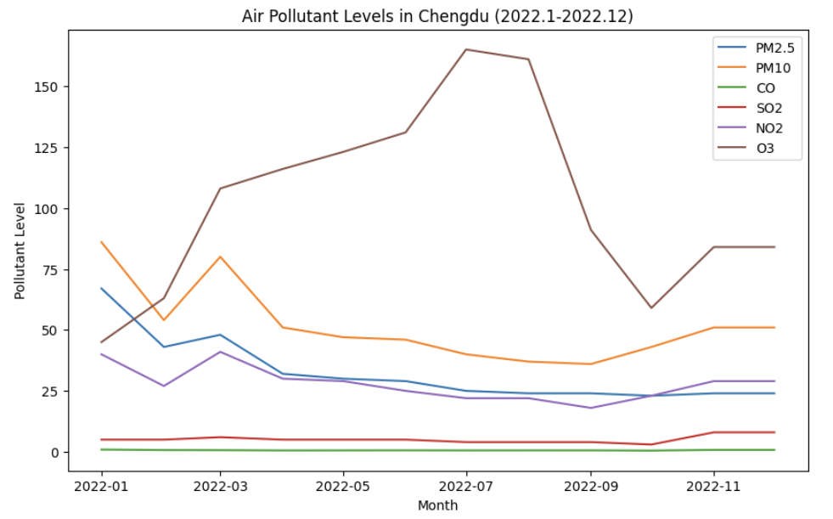
5
China’s livable cities
Exploration3: Main sources of air pollution in Chengdu in 2022
As can be seen from the picture above, in January 2022, the indexes of PM2.5 and PM10 were relatively high, which may be the main cause of air pollution in January; in July and August, it can be seen that the content of O3 is very high, which should This is the main reason for the high AQI index in Chengdu in July and August.

Slide 39
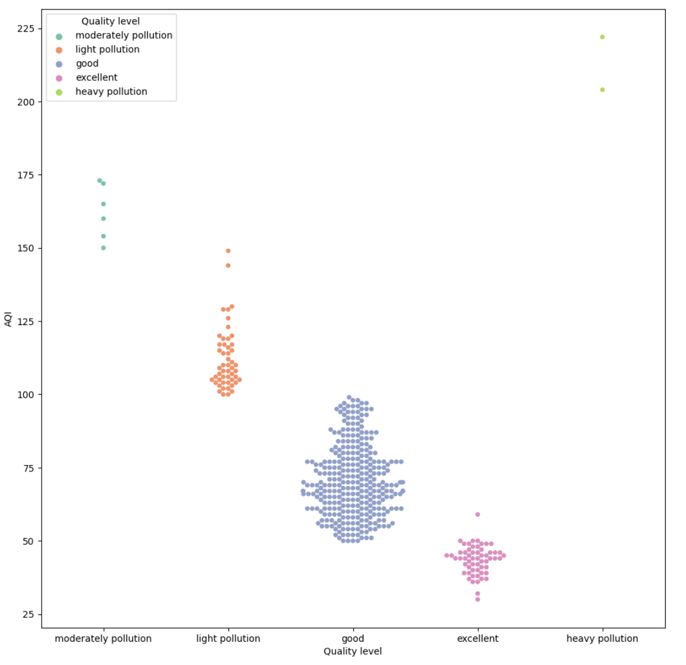
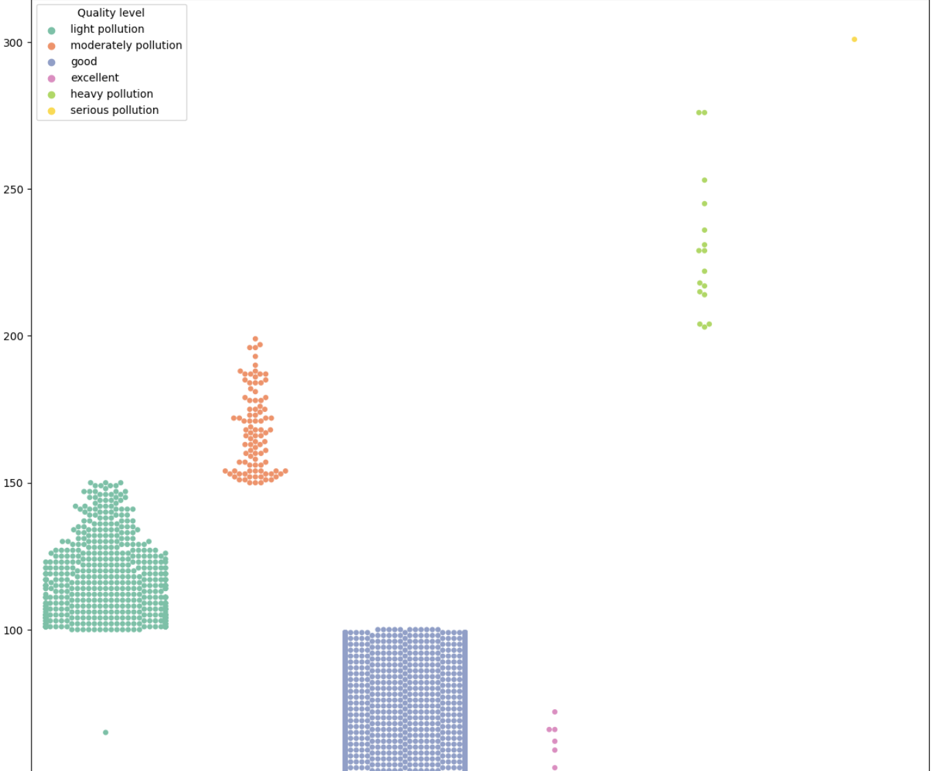
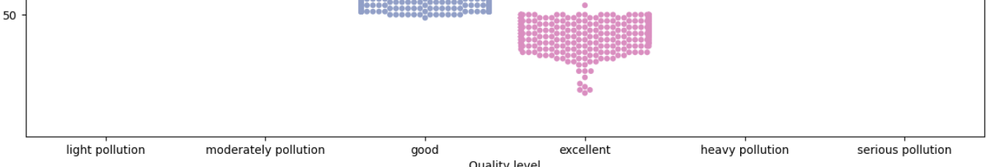
5
China’s livable cities
Exploration4: Comparison of Quality Level between 4 livable cities and 34 provinces and cities across the country
From the above two figures, we can find that the majority of Quality level is good, and there is a small data in the “light pollution”. However, in the second scatter, we can see that the majority of Quality level is light pollution and good. In short, relatively speaking, the air quality of the four livable cities is better than the national average air quality.

Slide 40
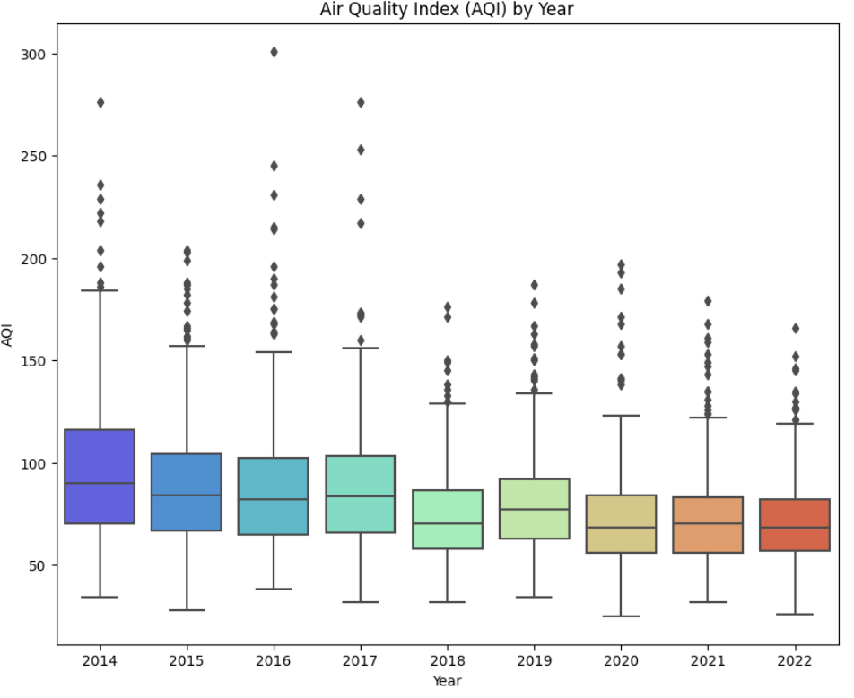
5
China’s livable cities
Exploration5: China’s Air Quality Change Trends from 2014 to 2022 (AQI)
As can be seen from the figure above, generally speaking, the AQI index has basically maintained a downward trend from 2014 to 2022, with the lowest value in 2018. A significant decrease can be seen in the maximum value of AQI, from about 180 to about 130. Therefore, it can be seen that from 2014 to 2022, China's air quality has improved significantly.

Slide 41
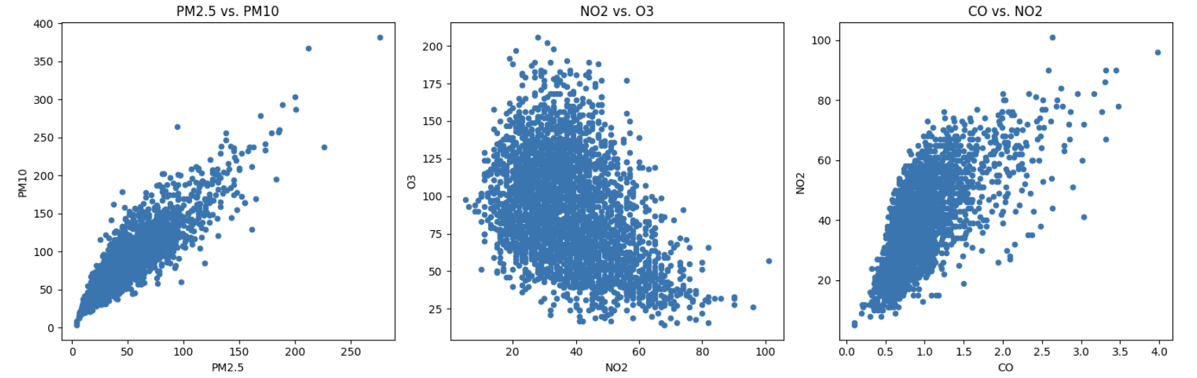
5
China’s livable cities
Exploration6: The relationship between different air pollutants and the relationship between all pollutants and AQI
As can be seen from the above three sub-figures, PM2.5 and PM10 are obviously positively correlated, CO and NO2 are obviously positively correlated, but NO2 and O3 are negatively correlated to a certain extent from the figure.

Slide 42
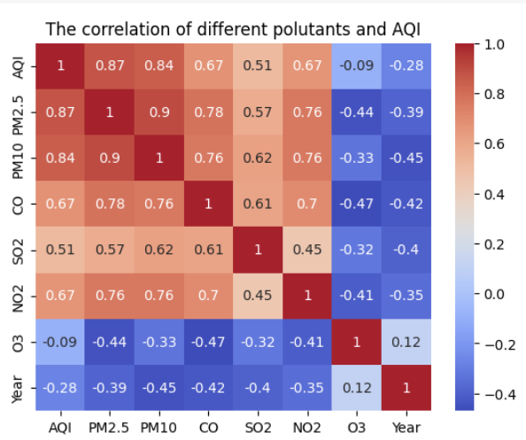
5
China’s livable cities
As can be seen from the above figure, PM2.5 and PM10 have the greatest impact on AQI. At the same time, the relationship between each pollutant can also be visually observed from the perspective of data.

Slide 43
6
Conclusion

Slide 44
Conclusion - Findings
(ZHANG Zhengyi) The air pollution situation in Shijiazhuang is indeed much worse than that in Beijing and Tianjin. But this does not confirm the rumors that Beijing absorbed the blood development of Hebei Province.
(XIAOXin) The air quality in the three moderately and severely polluted cities of Xi'an, Urumqi and Taiyuan is indeed not very good, which fits everyone's stereotype.
Among my country's first-tier cities, only Beijing's AQI is higher than the average AQI.
Everything else is good, especially Shenzhen
(ZHANGJie) The air quality in Changsha, Chengdu, Chongqing and Kunming is indeed very high. At the same time, my country's air quality continued to improve from 2014 to 2022, especially the maximum AQI value dropped significantly.

Slide 45

Conclusion - Findings
Judging from our intuitive analysis,
there are indeed seriously polluted cities in our country.
it is undeniable that under a series of air quality protection measures in China,
the AQI of our provincial capital cities has declined from 2014 to 2022,
and the air quality has indeed improved a lot.

Slide 46
Labor distribution matix
 | Data collecting | Coding | Story telling | PPT production | Presentation
ZHANG Zhengyi | √ | √ | √ | √ | √
XIAOXin | √ | √ | √ | √ | √
ZHANGJie | √ | √ | √ | √ | √

Slide 47
YOU
THANK

